Slide 1
quality assurance
In this modern era every one expect excellence and ingenuity in a product
In order to meet the expectation one must Be quick, precise and also better managed
reason is incase of mishap one can also quickly adapt or change a code or a future
Quality assurance ensure no mishap occur during the process

Slide 2

Quality assurance stands for
In order to meet the following need the sdlc is followed in order ensure sdlc is followed quality assurance is followed

Slide 3
Quality assurance vs. quality control
People often mistake quality assurance to quality control
quality assurance ensures that quality of method and productivity of product is ensured
quality control tests the level of the quality
Ensured of overall product
In quality control testing is done make sure
To deliver a better, faster or durable product

Slide 4
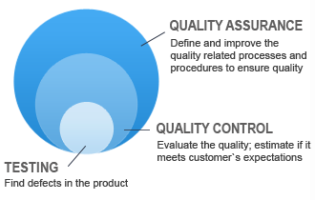
Diagrammatic comparison between quality assurance and quality control

Slide 5
Standards
ISO 9000 is an international organization to scale the quality on a standard method
ISO 9001:2015 sets out the criteria for a quality management system and is the only standard in the family that can be certified to (although this is not a requirement). It can be used by any organization, large or small, regardless of its field of activity. In fact, there are over one million companies and organizations in over 170 countries certified to ISO 9001 is a revised

